Slide 1


YouFit
Your Fitness Companion
Machine learning model

Slide 2
Team:
Gowtham Govindh - CB.EN.U4CSE21019
Sajith Rajan P - CB.EN.U4CSE21052
Samya Rebecca - CB.EN.U4CSE21053
Saravanak Karthick - CB.EN.U4CSE21054
Veda Yasaswani Suseela - CB.EN.U4CSE21066

Slide 3
Project Overview
•Problem statement
•Objective
•Data selection
•Dataset Description
•Data Analysis
•Model selection
•Data visualization
•Evaluation criteria

Slide 4
PROBLEM
STATEMENT
Problem Statement:In today's fast-paced world, individuals often struggle to make informed decisions about their fitness and overall health. Many people lack personalized guidance and insights into their fitness levels, making it challenging to set and achieve meaningful fitness goals. Moreover, the one-size-fits-all approach to fitness and wellness does not consider the unique needs and characteristics of each individual. This leads to suboptimal health outcomes and a lack of motivation to maintain a healthy lifestyle. There is a pressing need for a solution that can provide personalized fitness predictions, guidance, and motivation, helping individuals make informed choices and take control of their well-being.

Slide 5
SOLUTION:
•To collect the information from the watch and identify what kind of exercise the person is doing(Decision Tree)
•BMI classification (Random forest) and Food Recommendation
•Calculating respiratory fitness and classifying (Naive based-Gaussiant)
•Calculating heart points based on calories and step count(Multiple linear regression)
Disease Classification

Slide 6
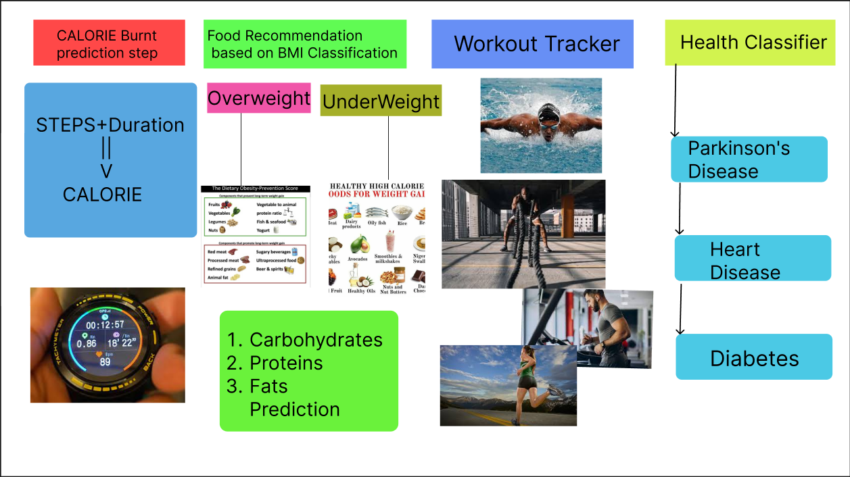

Slide 7




Tech Stack:
Plan to deploy at Streamlit

Slide 8

Model-1

Slide 9
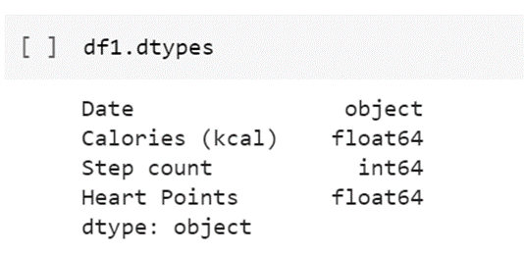
Data Selection
The data used are numerical values
calories(kcal): A calorie is a measure of energy expenditure and stored energy
step count: measure steps and/or distance travelled.
heart points: predicts the heart points based on step count and calories. They represent a minute of moderate exercise

Slide 10
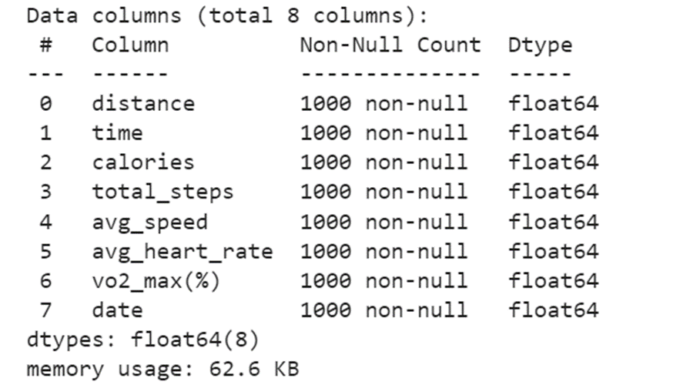
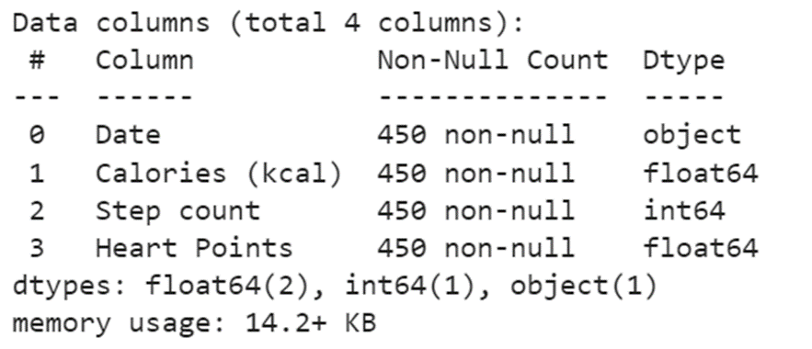
Data Description

Slide 11
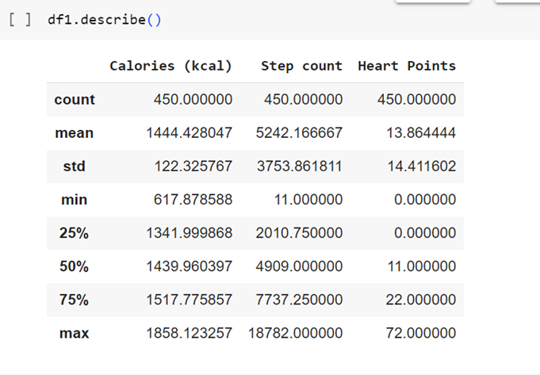
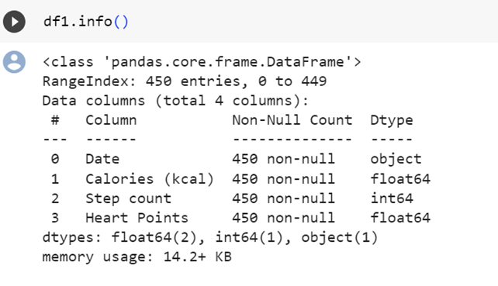
DATA ANALYSIS

Slide 12
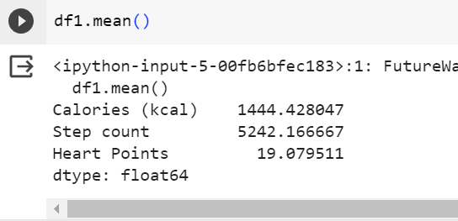
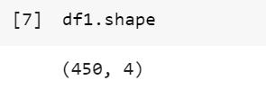
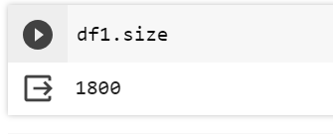

Slide 13
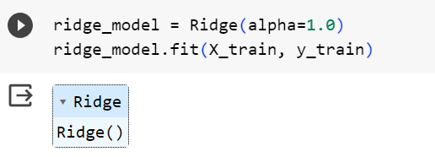
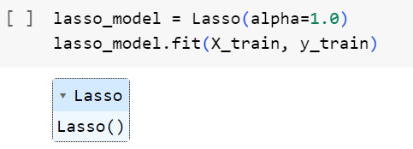
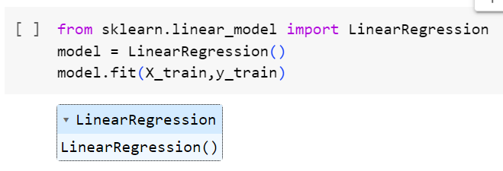
Model Selection
The best model that can be implemented here based on the attributes used, is multiple linear regression, since we use numerical values like calories and step count to predict heart points.
Lasso and ridge is also implemented.

Slide 14
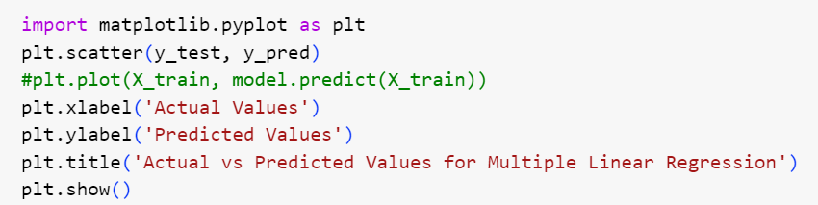
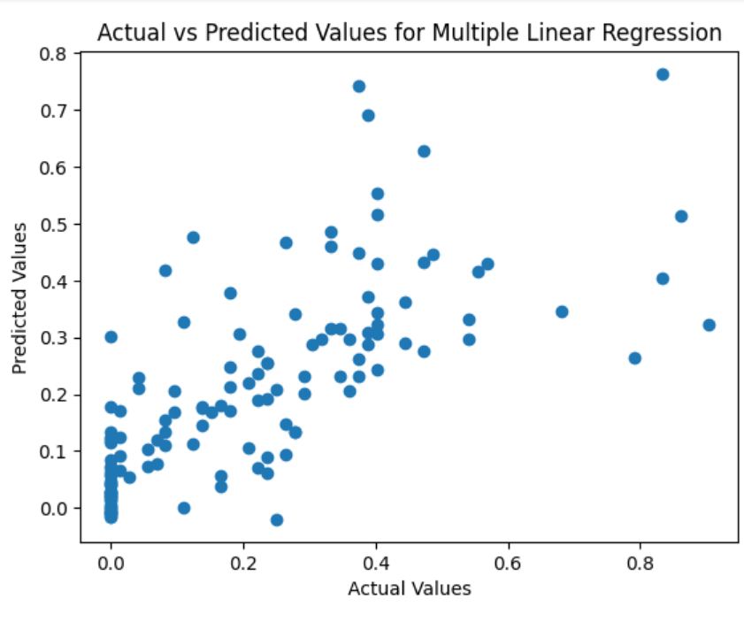
Data Visualization

Slide 15
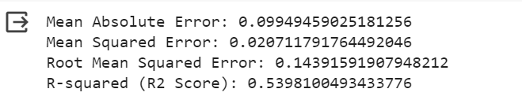
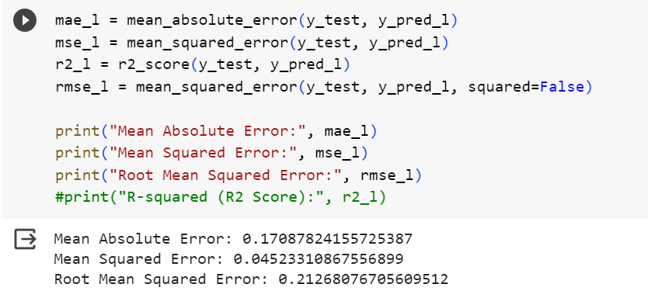
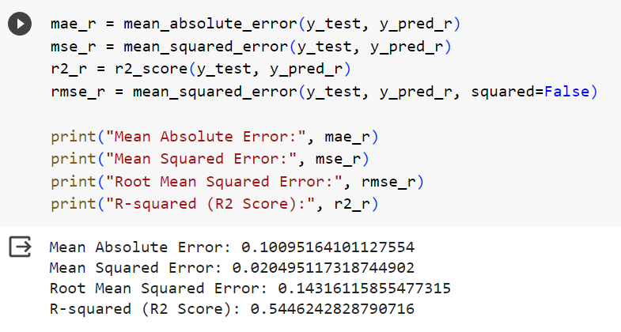
Evaluation Criteria
Multiple linear regression
Lasso
Ridge

Slide 16
Model-2

Slide 17
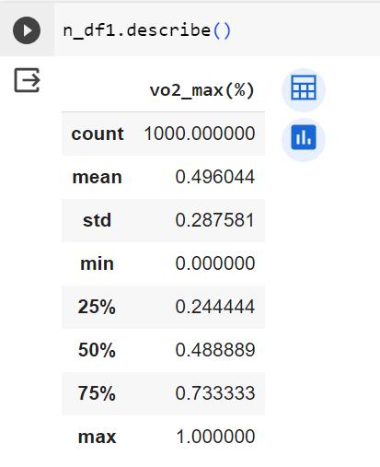
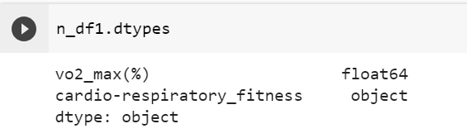
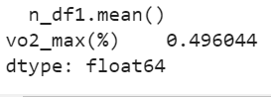
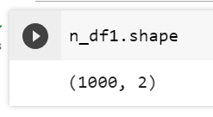
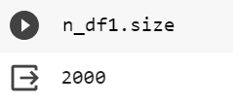
Data Analysis

Slide 18
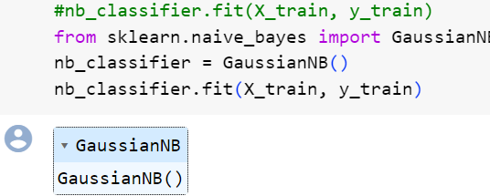
Model Selection

Slide 19
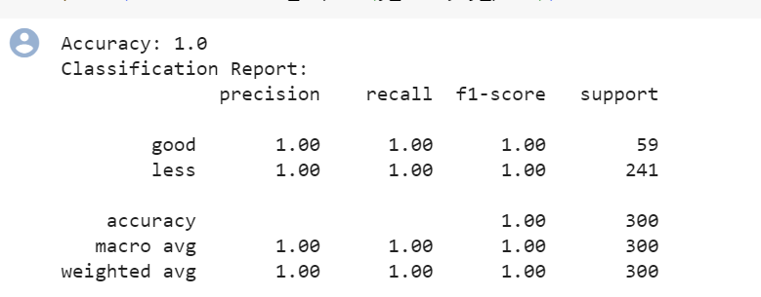
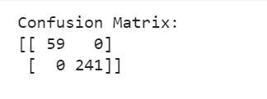
Evaluation Criteria

Slide 20
Model 3

Slide 21
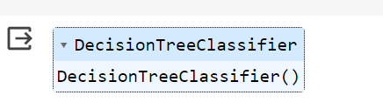
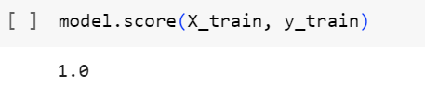
Model Selection

Slide 22
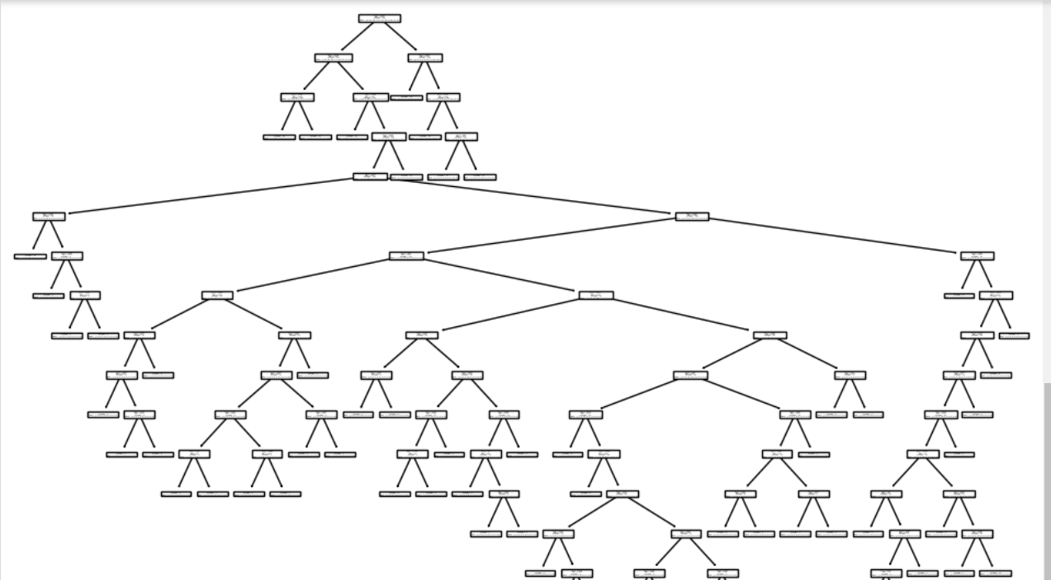
Evaluation Criteria
Tree Plot

Slide 23
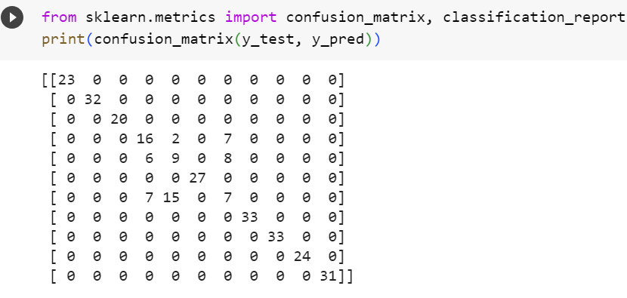
Confusion
Matrix

Slide 24
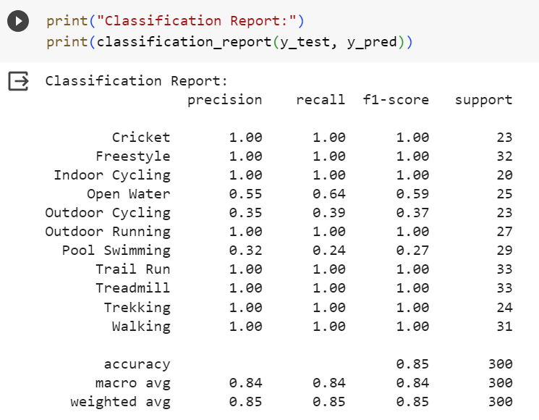
Classification
Report

Slide 25
Model 4

Slide 26
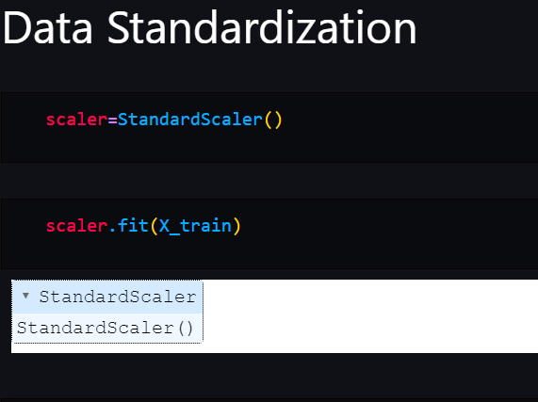
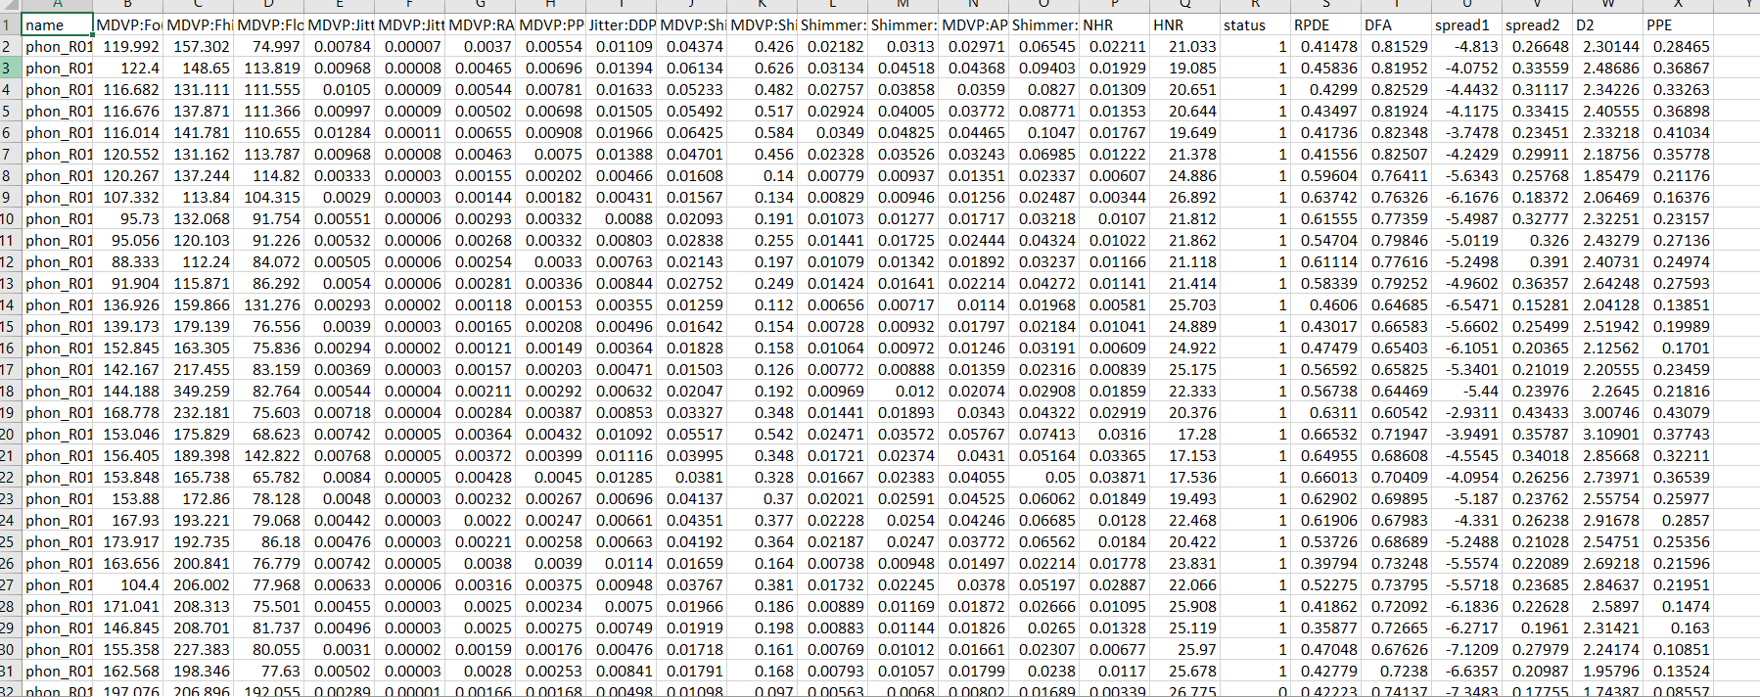
PARKINSON'S DISEASE
Dataset
Preprocessing

Slide 27
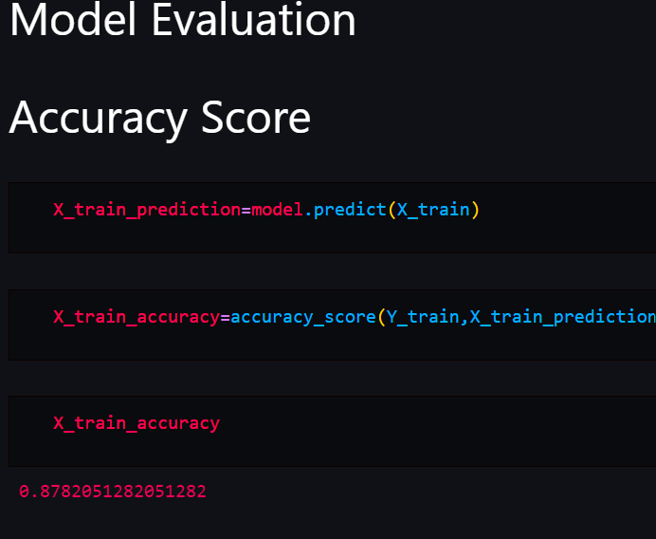
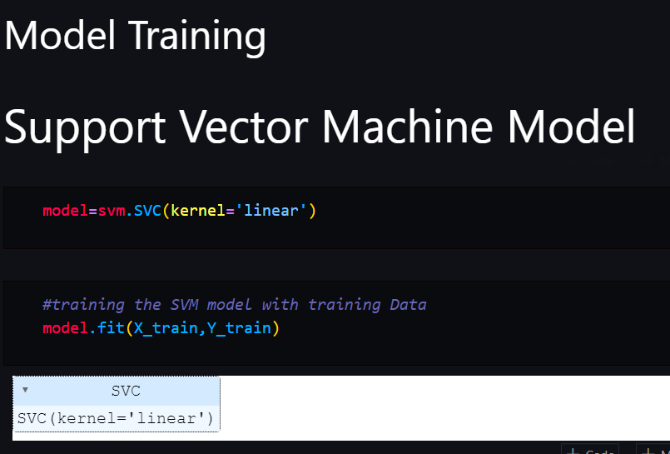
SVM
Result
Training

Slide 28
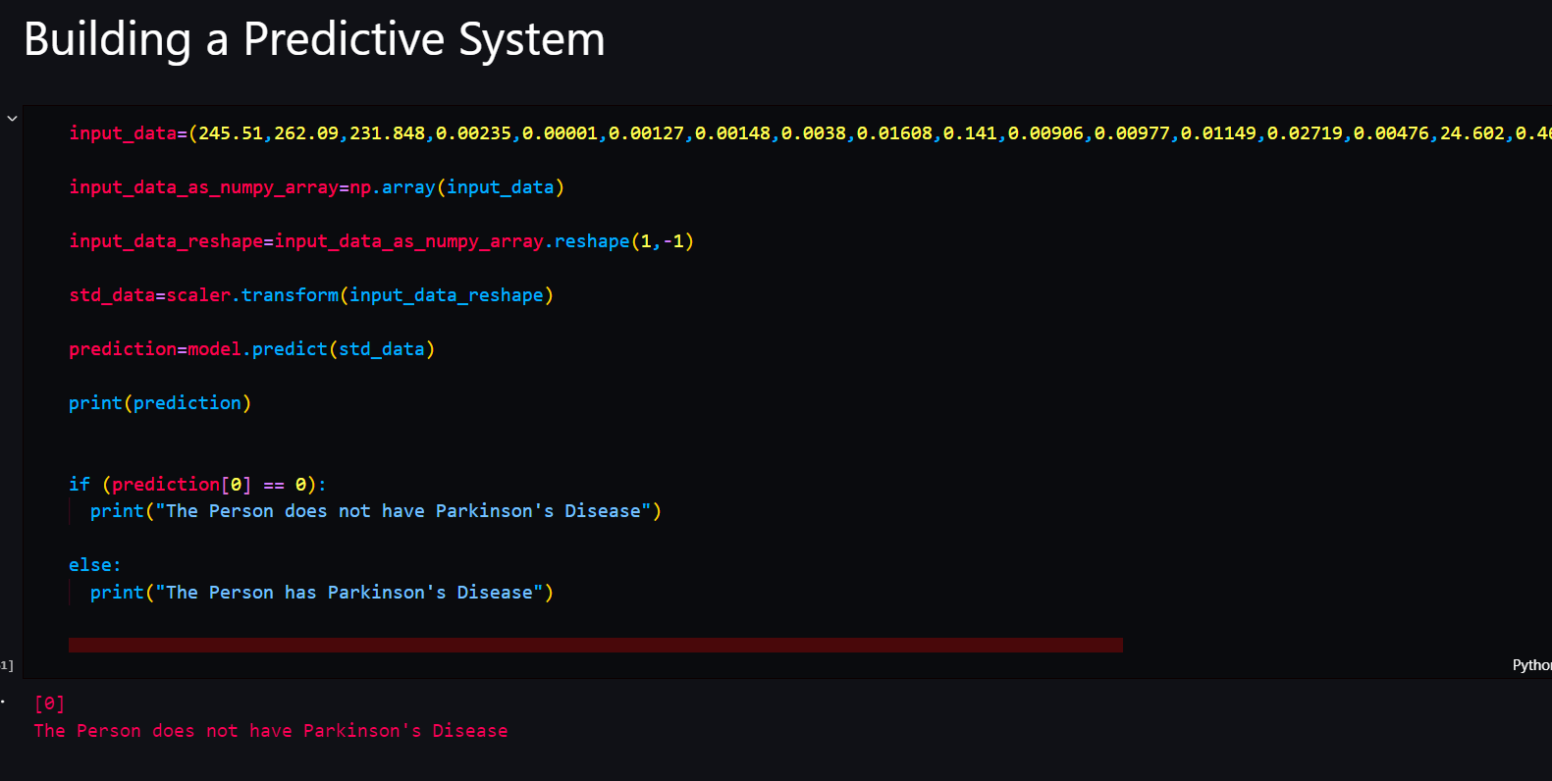
Prediction

Slide 29
Analysis

Slide 30
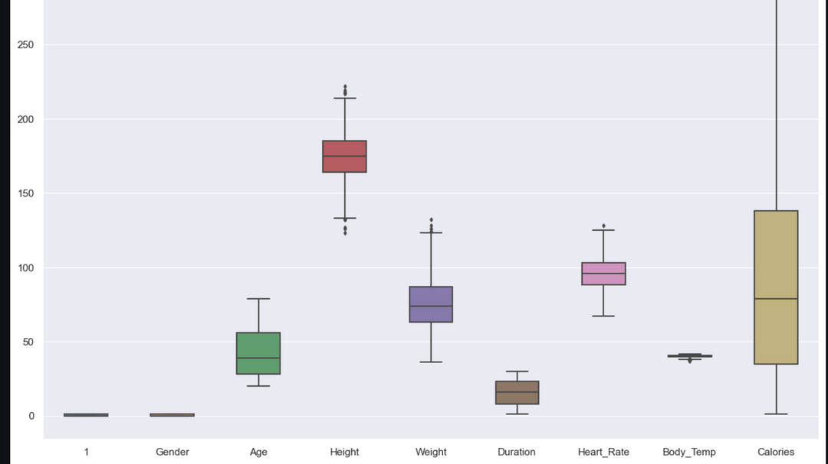
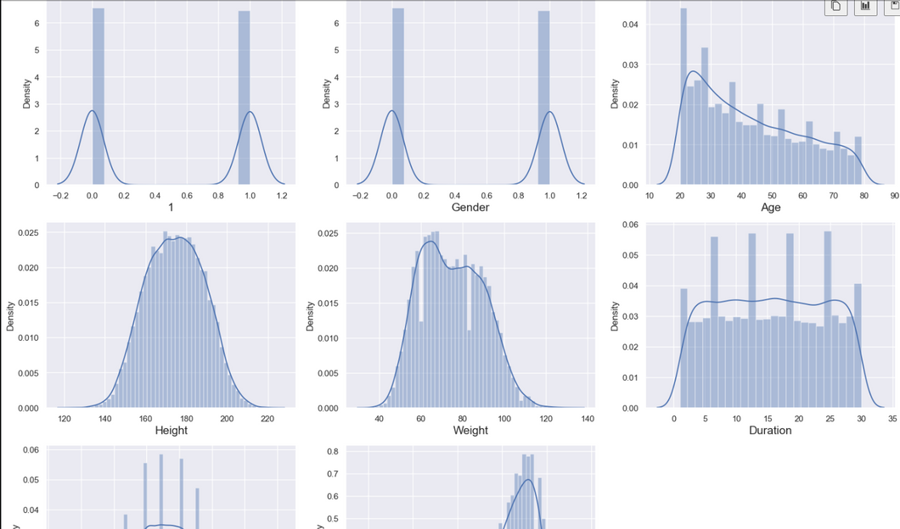
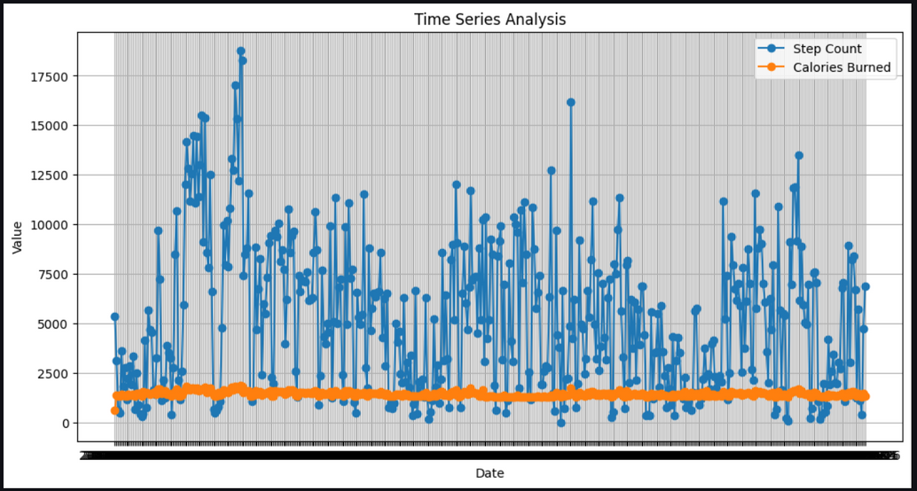
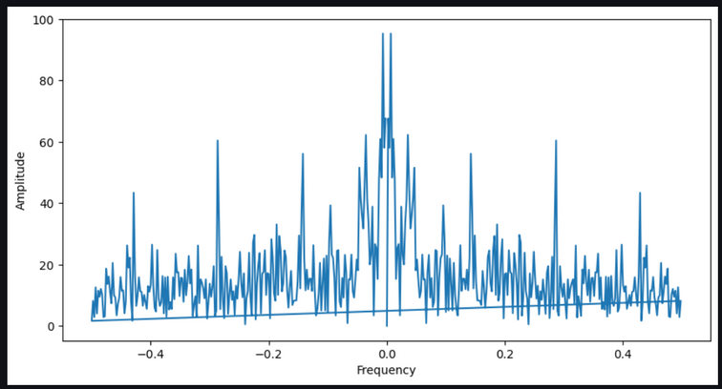
Visualization

Slide 31
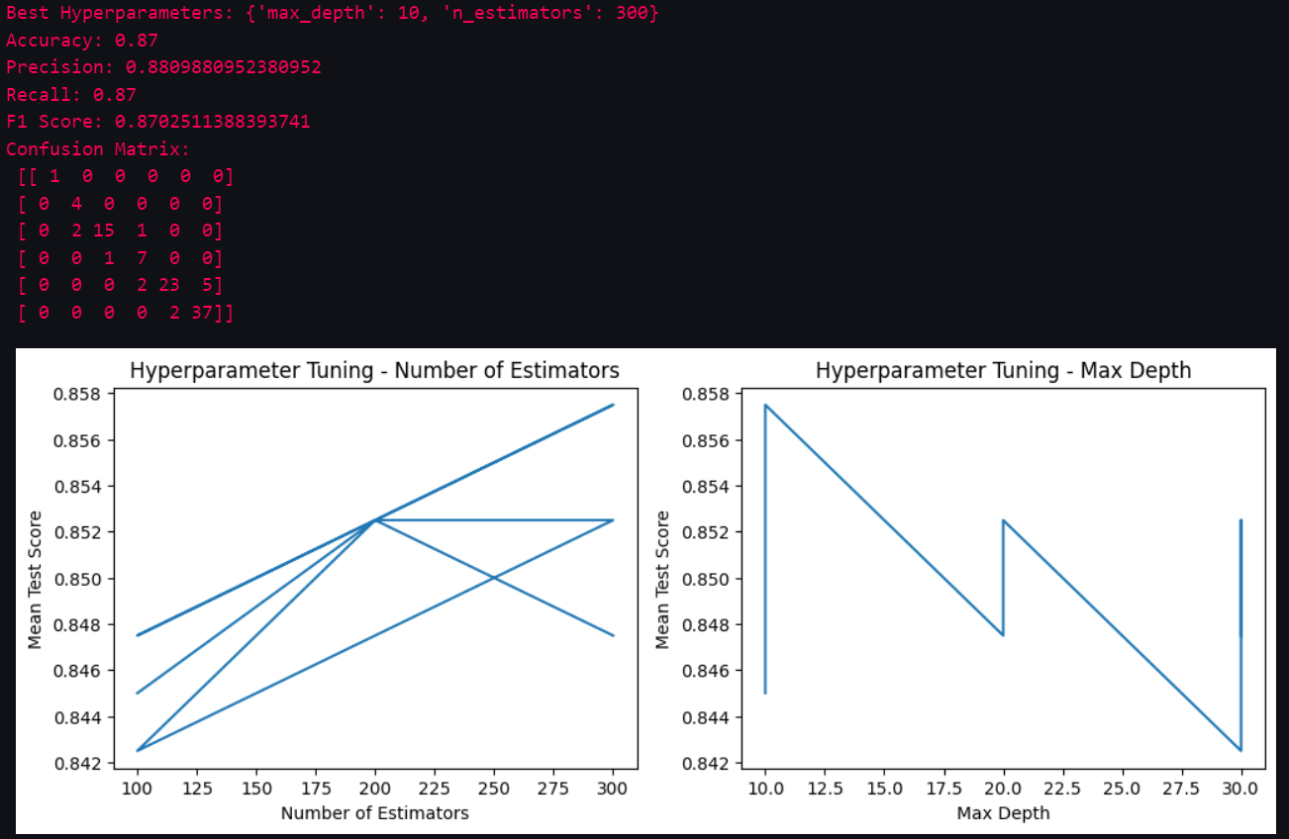
Hyperparameter Tuning

Slide 32
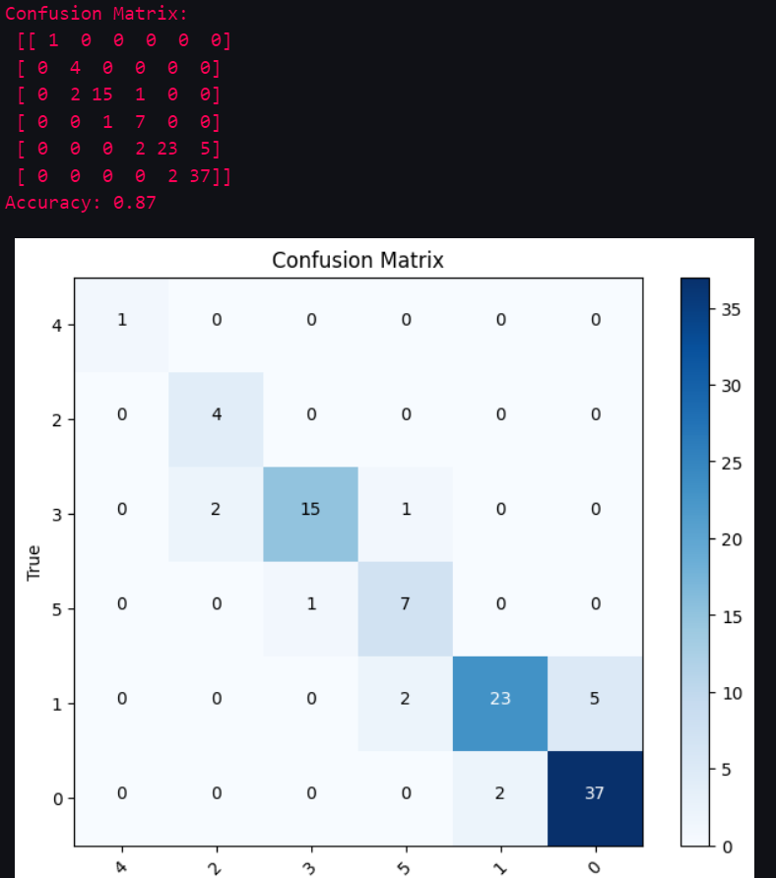
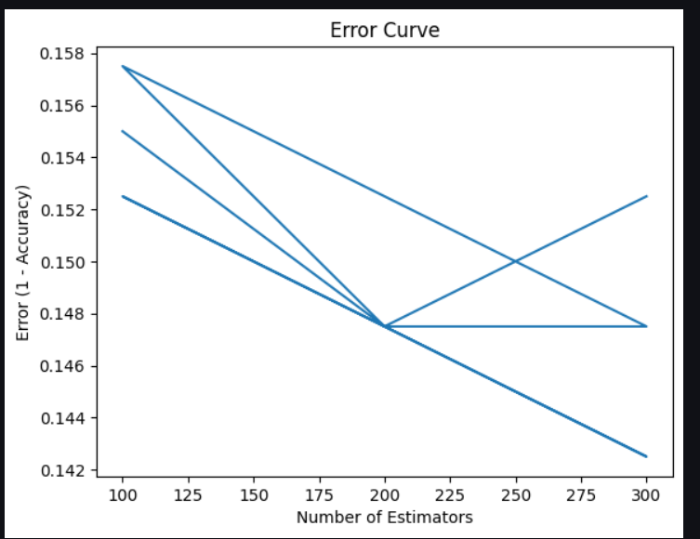
Performance metrics
Error

Slide 33
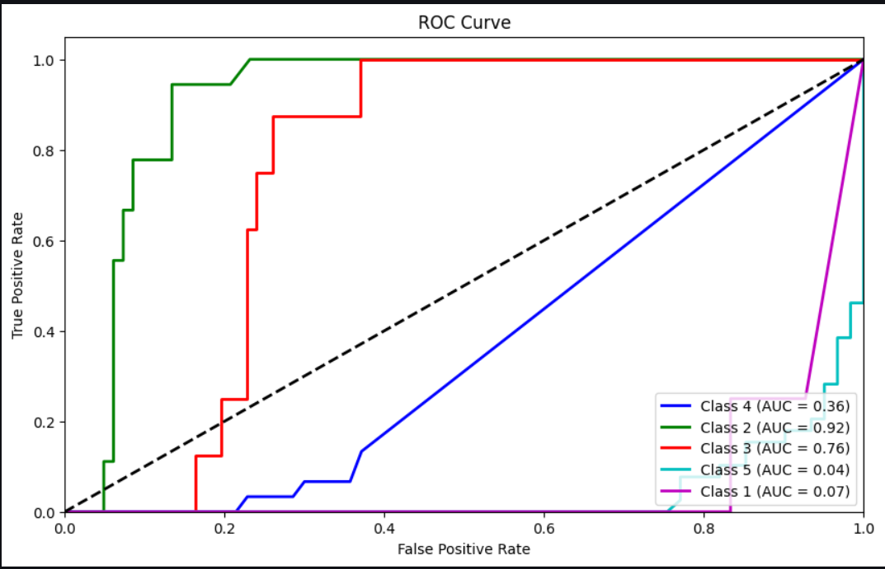
Curve:

Slide 34
Reference
https://towardsdatascience.com/predicting-my-next-workout-with-machine-learning-part-1-2fdb07f9ded2
https://www.perfectgym.com/en/blog/new-features/machine-learning-gym-management

